Slide 1

Forecasting Crude Oil Price
Group : 6
Mentor : Neha Ramchandani

Slide 2


GROUP MEMBERS:
Deshmukh Mangesh P
Sanish Kumar
Prathmesh Pawar
Baba S M
Rachi Dalal

Slide 3

Objective
Oil is a commodity notorious for being able to go in the complete opposite direction after a single market event.
This is because the fundamentals of oil price are rarely based on real-time data, instead, it is driven by externalities making our attempt to forecast it even more challenging.
As the economy will be highly affected by oil prices. Our model will help to understand the pattern in prices to help the customers and businesses to make smart decisions.

Slide 4

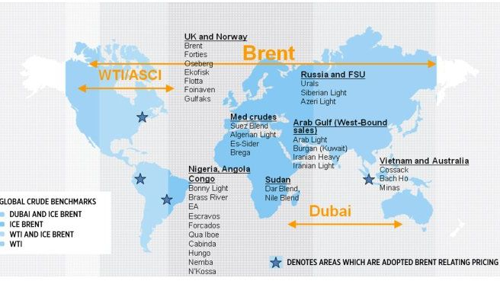
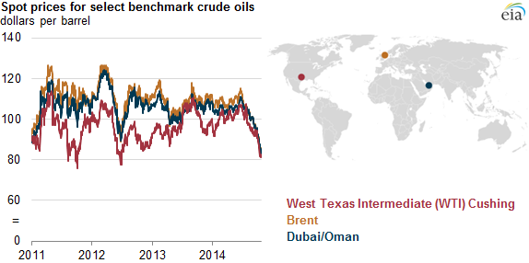
A benchmark crude is a crude oil that serves as a reference price for buyers and sellers of crude oil.
There are three primary benchmarks
West Texas Intermediate (WTI)
Brent Blend
Dubai Crude.

Slide 5

Project Flow

Slide 6
Data Collection
We extract latest data from Investing.com from 07/10/2018 to 10/09/2023 to the existing dataset.
Investing.com is a financial platform and news website; one of the top three global financial websites in the world. It offers market quotes, information about stocks, futures, options, analysis, commodities, and an economic calendar.

Slide 7
Dataset
Downloaded the Crude Oil Closing Value data from Investing.com website and joined with the given dataset.
Dataset consist of 2nd Jan 1986 to 9th Oct 2023 of daily crude oil price.
So, further analysis done on this combined new dataset.

Slide 8


Exploratory Data Analysis (EDA)

Slide 9
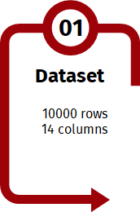
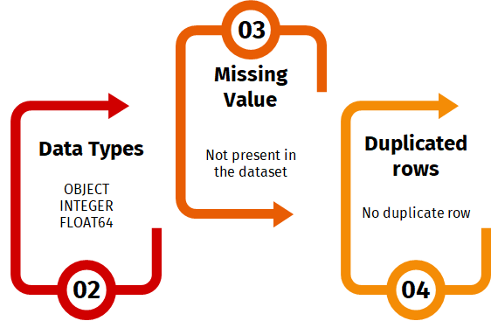

Inferences from Data-Set
9612 Rows
2 Columns
There are 7 null values which are filled by ‘Ffill method’
Date-time
Float
There are no ‘Duplicate rows’ present in data-set

Slide 10
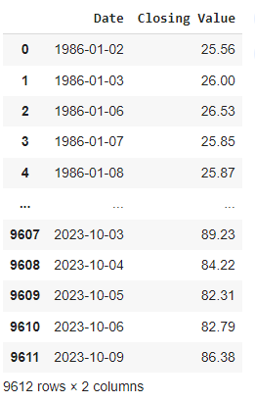

In the left side image in this same slide, we have noticed that, the Dataset doesn’t contain the values for Saturday and Sunday.
For example, if you look closely at 7th and 8th October (Saturday & Sunday), we can see that they are missing, and this all because the Oil Market is closed on weekends.

Slide 11
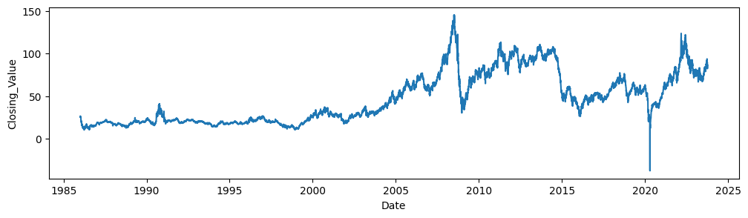
From the above Line Graph, we can say that the Crude Oil Prices has tend to show an UPWARD trend from 1987 till 2007.
In the Year 2008, the Great Recession occurred and then Oil Prices dropped suddenly.
After the Great Recession, Oil Prices started to rise till the year 2011.
Then from 2011,Oil Prices were dropping dramatically towards 2015.
From year 2015 onwards, the Oil Prices seem to fluctuate with some peaks and falls till the 2020 Pandemic Year.
From year 2021 till present it is showing a Growing Trend.

Slide 12
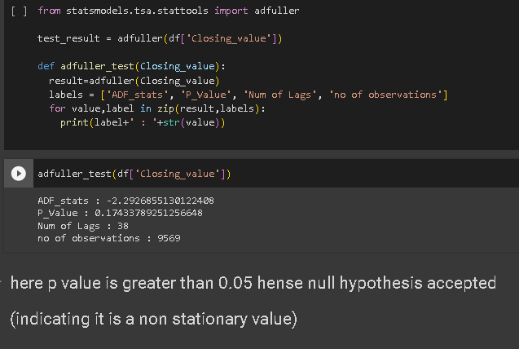
Stationarity
From Dickey Fuller Test , we get P-value more than 0.05 which indicate ‘Data is not stationary’.

Slide 13
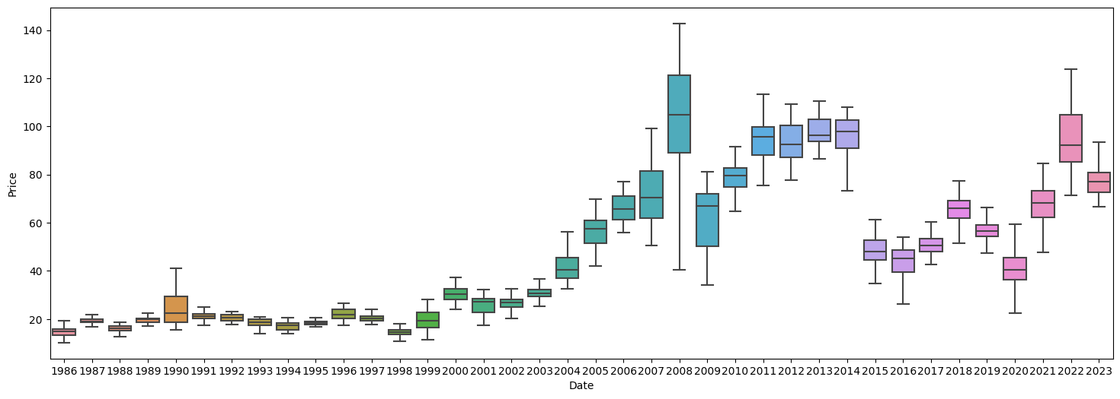
We can see the oil price range by year and month.
Most of the years except 2008, 2014, and 2022 The box plot is comparatively short, meaning less fluctuation in terms of price.
In the year 2008, the box plot is comparatively tall, showing high fluctuations in price.

Slide 14
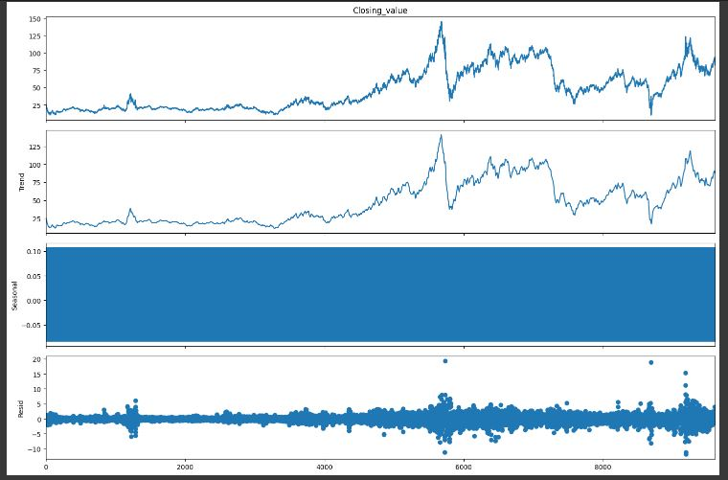
Decomposition Plot

Slide 15

Split-Train & Test
The final data after data processing was split into train data and test data
Training Data : 70% of Dataset
Test Data : 30% of Dataset

Slide 16
Model Building
Model | Order | RSME Value
ARIMA | 0,0,0 | 26.48
SARIMA | 2,1,0,12 | 25.13
XGBoost | - | 3.0637
The Forecast model was build based on XGBoost Model has it gives the least RMSE value

Slide 17
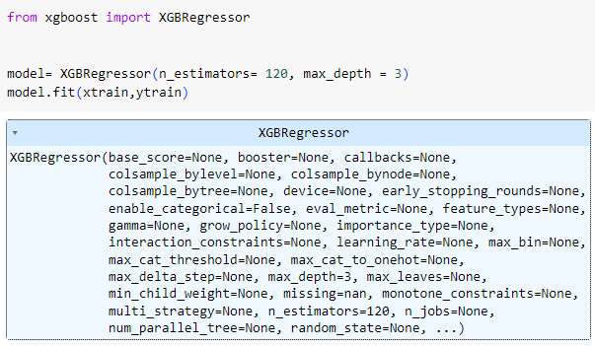
Final Model Building using XGBoost

Slide 18
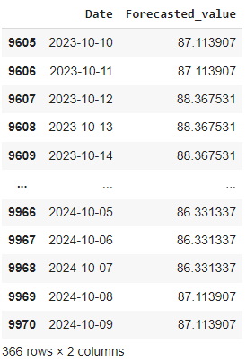
Forecasted Value Using XGBoost Model

Slide 19
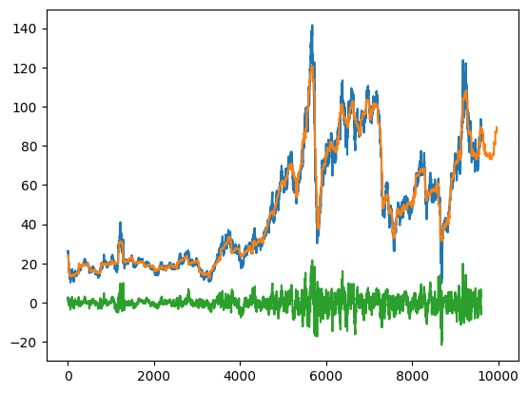
Crude Oil Forecasted Value Line Plot

Slide 20
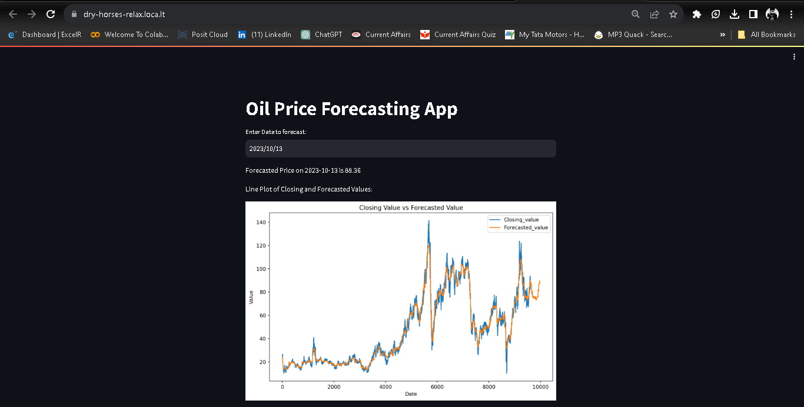
Deployment

Slide 21
CHALLENGES FACED
Webscrapping
Eliminating Outlier
CHALLENGES
Model Building
Increasing Model accuracy

Slide 22
CONCLUSION AND IMPROVEMENTS
It can be inferred that on the whole Dataset, XGBoost Model provides the best result in terms of accuracy for the given dataset.
Outliers in the data have been removed using box cox method for better accuracy and better forecasting result.
To make the data stationary , differencing method gave the least p-value.
The above improvements have helped in getting a good accuracy for the final model.

Slide 23
Thank You

